Slide 1
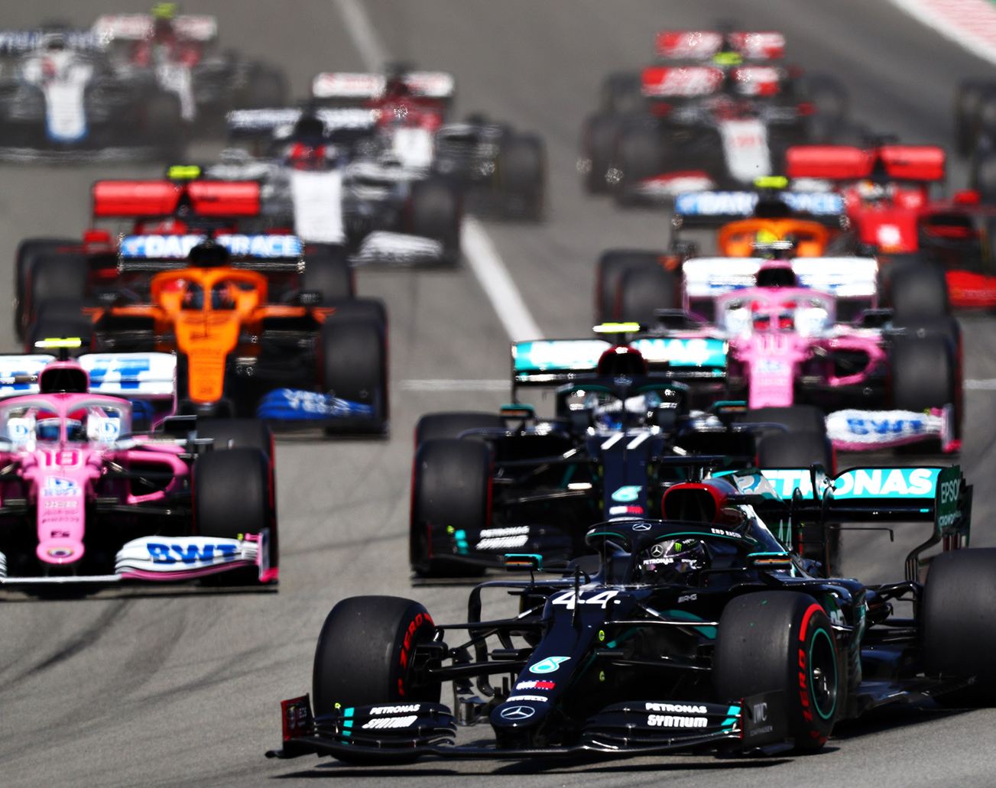
Formula 1 Race Finish Prediction
Adriana Ene + Elias Crum

Slide 2
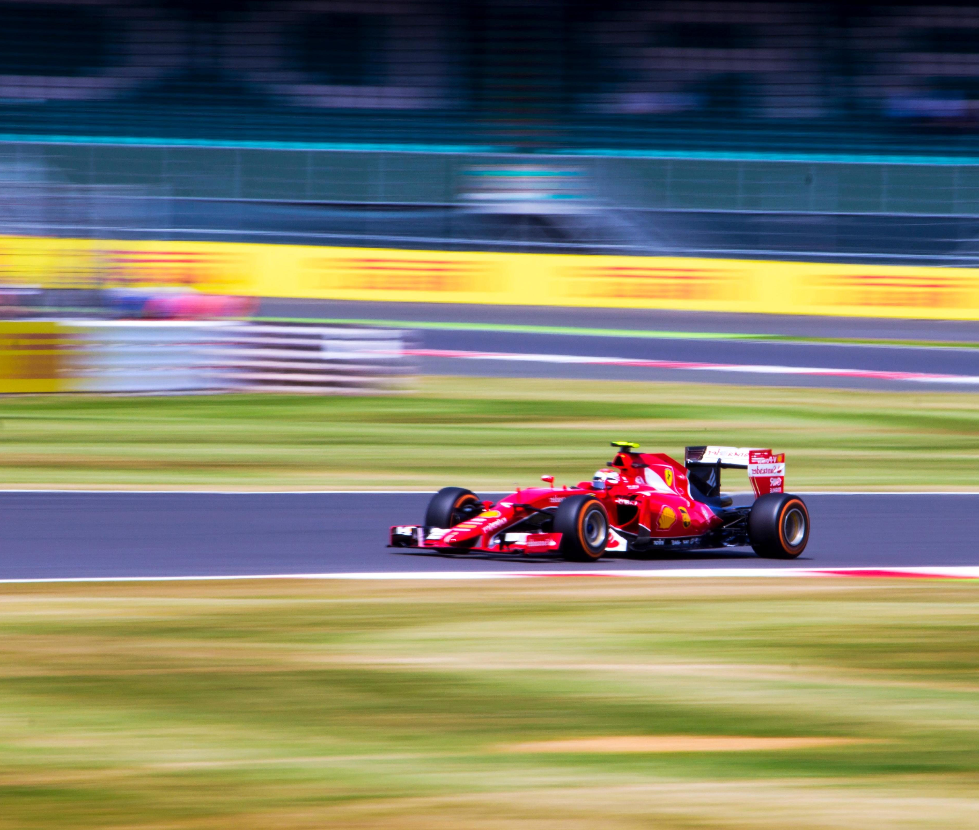
Formula 1 Basics
Car Racing
Rules:
10 team (constructors)
2 cars per team
Each car has 1 driver
Around 20 races per season
Top 10 finishing positions awarded points toward Drivers' and Constructors' Championships
Constructors' Championship
Drivers' Championship

Slide 3
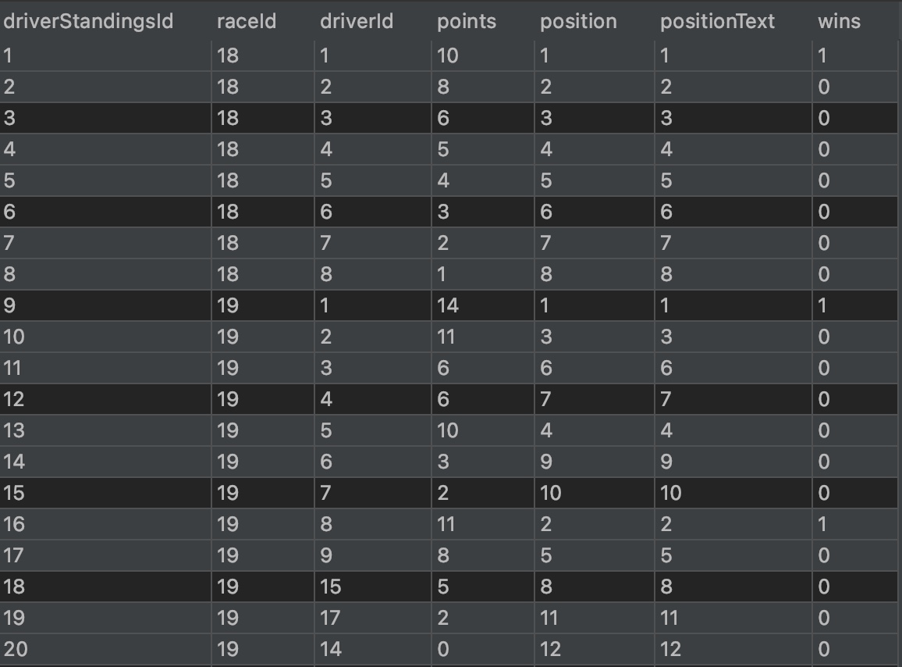
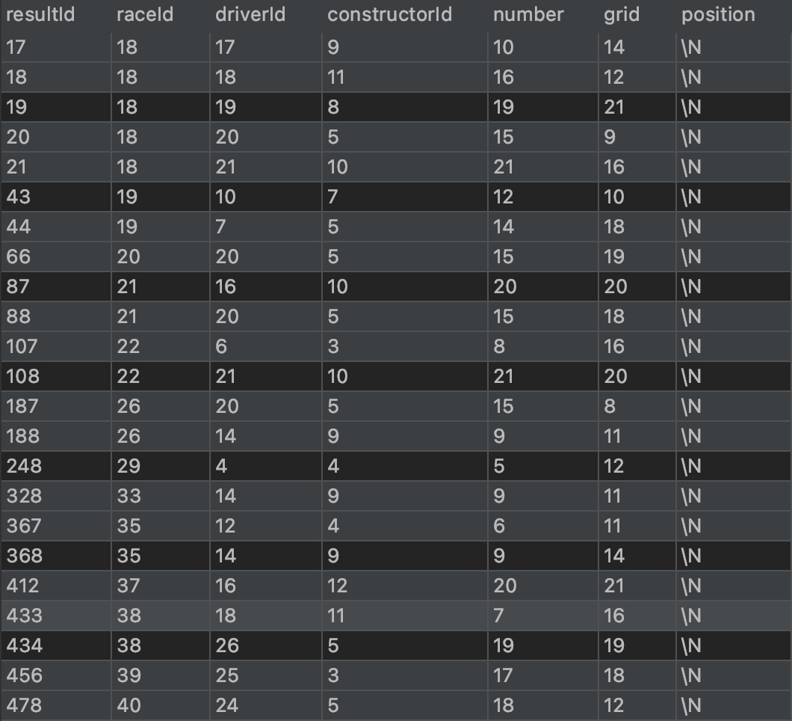
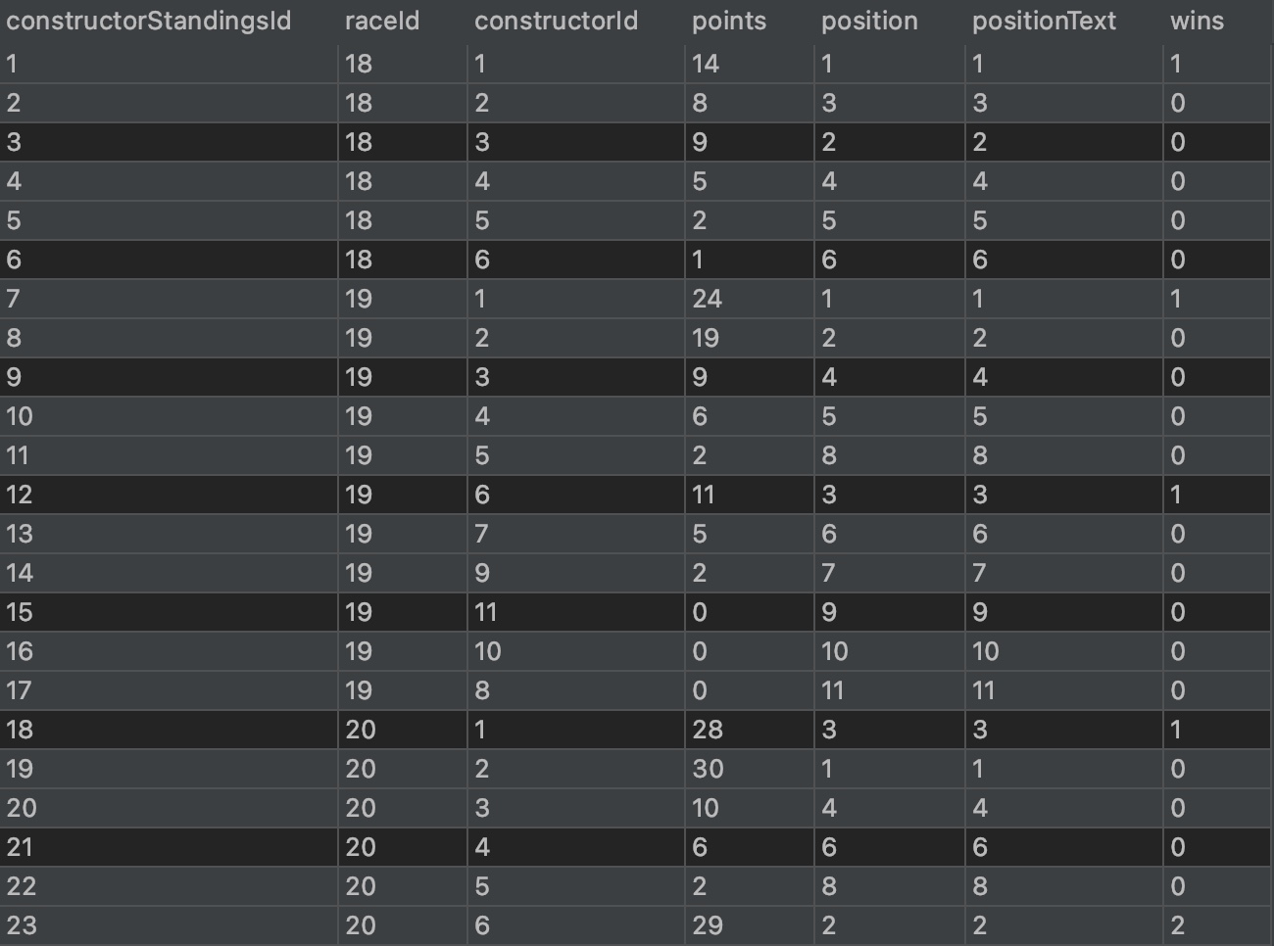
F1 Data Set
Combined 3 datasets into one dataframe

Slide 4
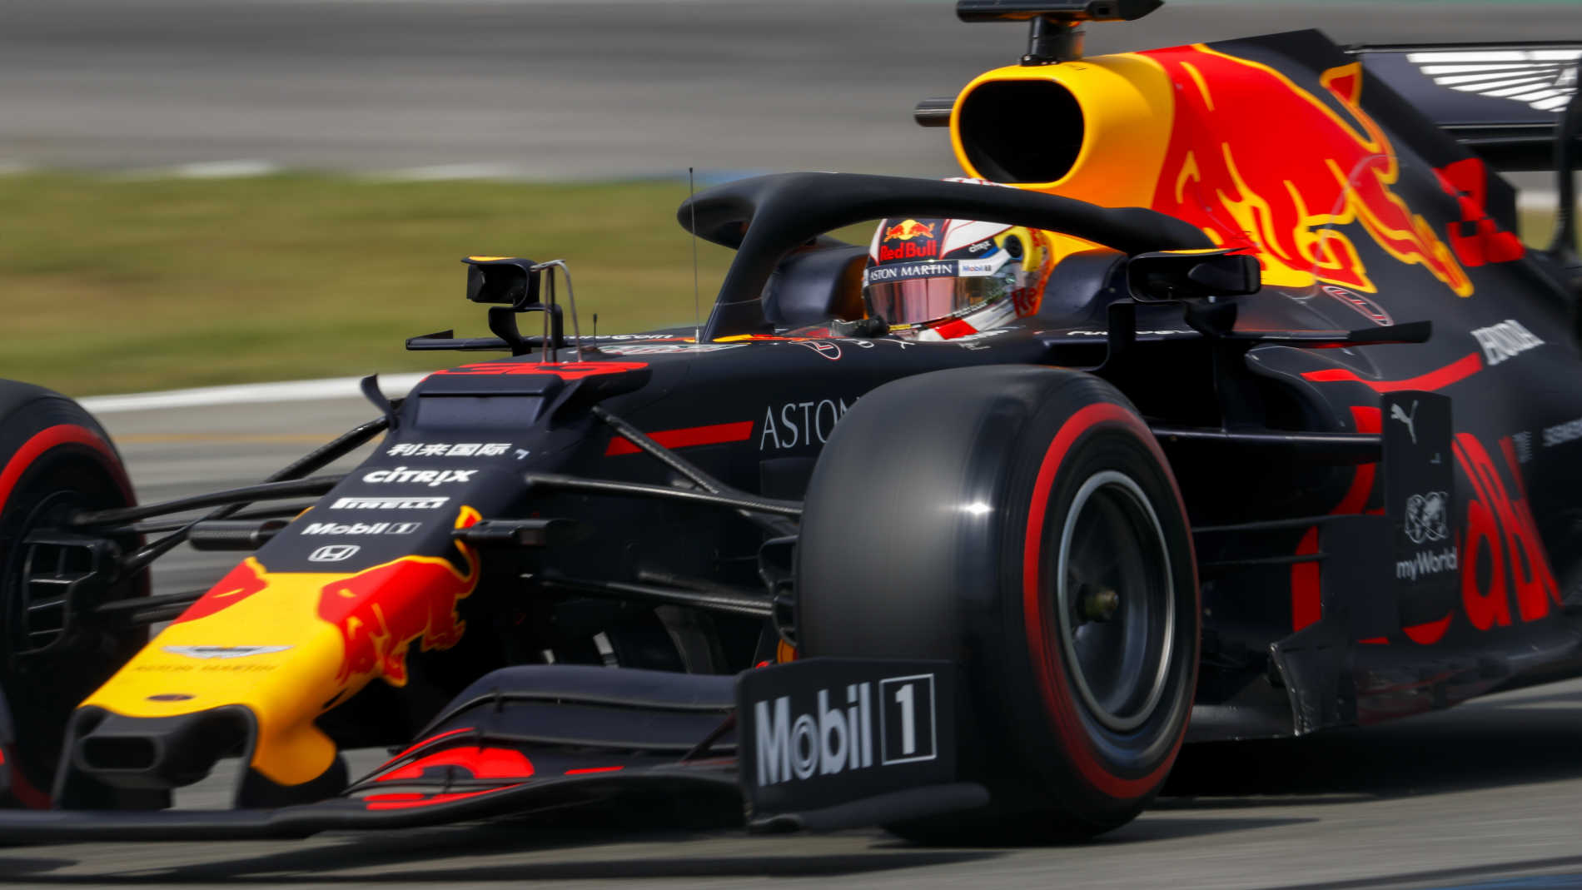
Important F1 Data Set Features
We needed to remove all columns that are very predictive. For example fastest race time and rank of winner.
There are drivers who never finished the race and their position and rank was missing, we added their position to be 21.

Slide 5
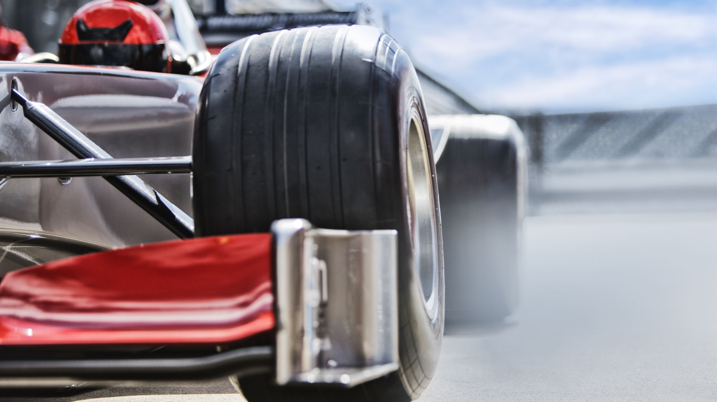
Important F1 Data Set Features
Some racers did not have a fastestLap so we needed to replace the missing values to 0.
There were 6 rows where even after cleanup, they had missing data. We had to find and remove them independently.
Challenge: Clean Dataset of missing values ("\\N")

Slide 6
Features used
raceId = id of the race, unique to each race
driverId = id of the driver, unique to each driver
constructorId = Id of constructor
number = Car number
grid = Position in starting grid (where
laps = numbers of laps
fastestLap = lap number when driver's fastest lap occurred
Rank = rank of the driver’s fastest lap compared to other drivers
Wins = Number of wins
Points = Points
Position = Final position. This was used for our results

Slide 7
2 Different Dataframes
Uncategorized: The finishing position (rank) of each driver after each race (1-21)
Categorized:
Podium winners (Ranks 1-3) == 0
Points winners (Ranks 4-10) == 1
>10 == 2

Slide 8
Using Grid Search to find the best parameters for SVM and logistic regression
Parameters searched for SVM:
kernel = ['linear', 'rbf’] C = [0.001, 0.01, 0.1, 1, 10, 100, 1000, 10000]
Parameters for Logistic Regression
penalty = ['l2', 'none’] C = [0.001, 0.01, 0.1, 1, 10, 100, 1000, 10000]

Slide 9
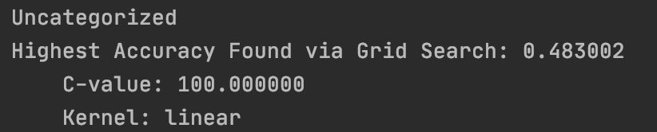
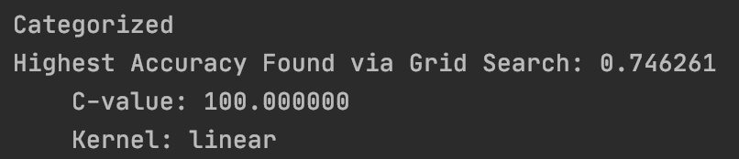
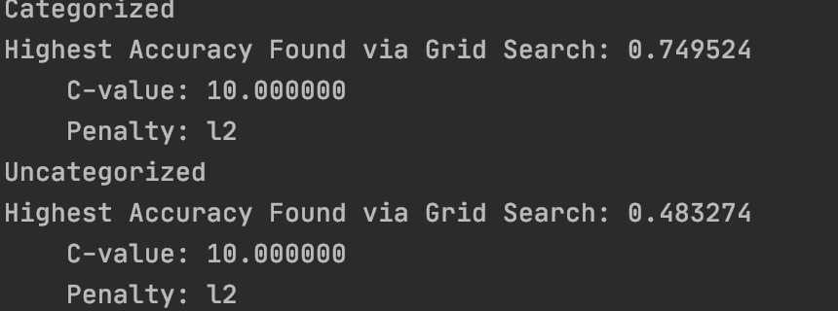
Results of Grid Search on the development set
SVM
Logistic Regression

Slide 10
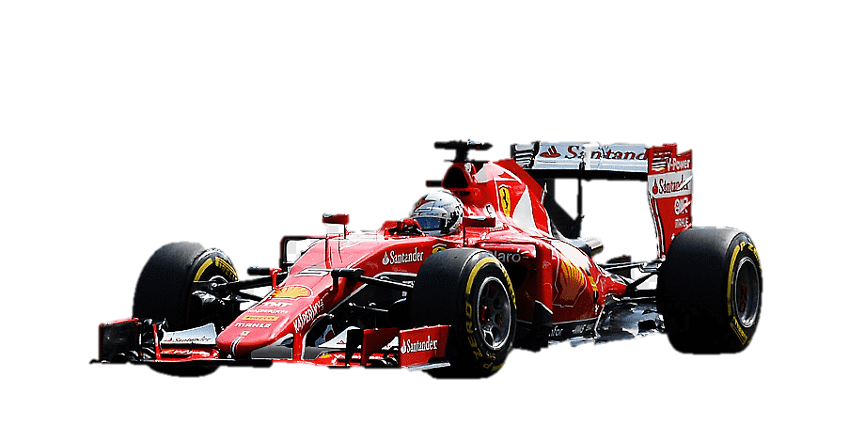
Baseline model Control
We used the dummy_classifier(strategy='uniform')
Unclassified data the accuracy was 0.04
Classified the accuracy was 0.32

Slide 11
Results using the best parameters found
SVM
Uncategorized SVM model accuracy: 0.475
Categorized SVM model accuracy: 0.741
Logistic Regression
Uncategorized Logistic Regression model accuracy: 0.447
Categorized Logistic Regression model accuracy: 0.742

Slide 12
Thank you!
Questions?

